Slide 1

SOFTWARE ENGINEERING PROJECT (CS331)
HOMEBAZAAR(REAL ESTATE APPLICATION)
GROUP MEMBERS:
Vikas Paswan
Om Prakash
Mritunjay Kumar

Slide 2
Contribution
OM PRAKASH
Backend
SRS Document, Data Flow Diagram and Use Case Diagram
Testing Report and Presentation
Searching
Chat
Home, Footer and Navbar.
VIKAS PASWAN
Backend
SRS Document, Data Flow Diagram and Use Case Diagram
Testing Report and Presentation
Chat(Socket)
Dashboards
Apartments
MRITUNJAY KUMAR
Backend
SRS Document, Data Flow Diagram and Use Case Diagram
Testing Report and Presentation
Login/Signup
Complaint, About and Responsiveness
Chat

Slide 3
INTRODUCTION
This “HomeBazaar(Real Estate)” application is to keep the sellers and buyers connected through a virtual platform and thus saving their time.
It is a user-friendly application for real estate which allows the buyer to search the property according to their demands and range in just one click.
It allows the seller to post the property, delete the property and view its owned properties.

Slide 4
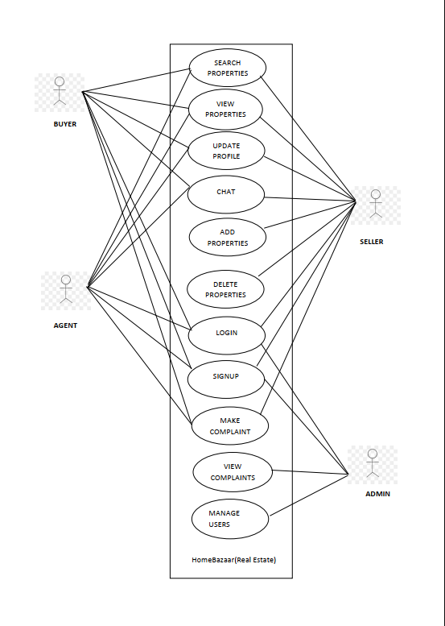
USE CASE DIAGRAM

Slide 5
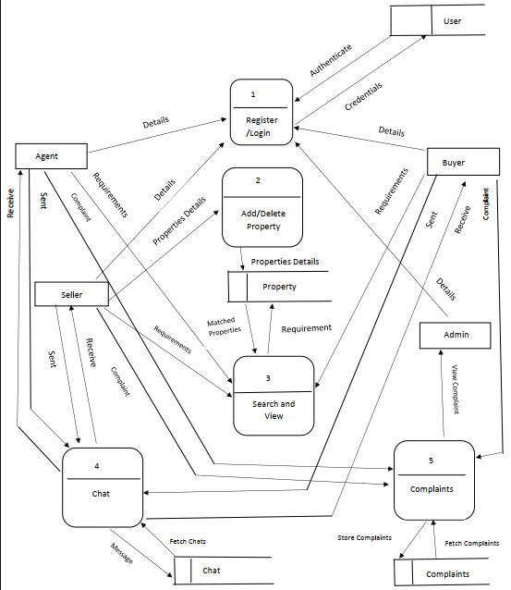
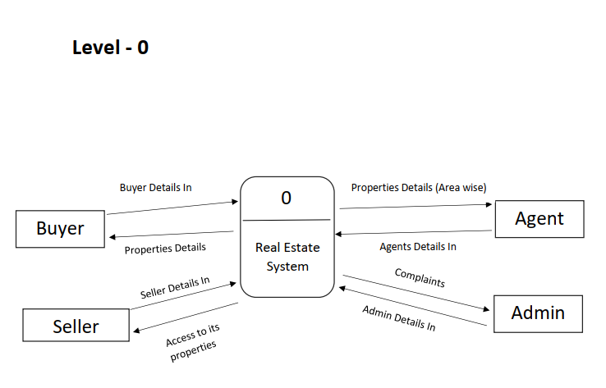
DATA FLOW DIAGRAM
Level 1

Slide 6
USER

Slide 7
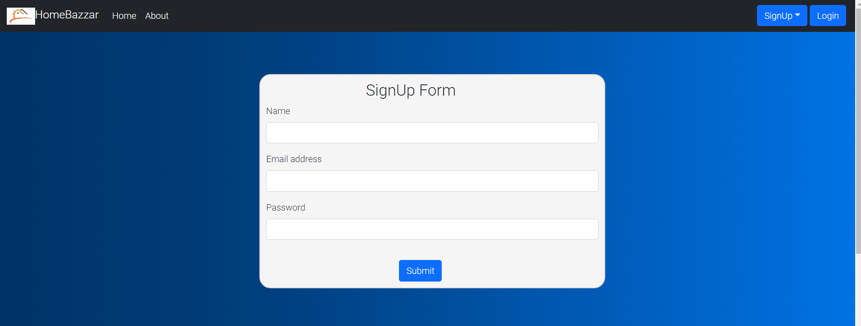
New users must provide name, email address and password during the sign-up process.

Slide 8
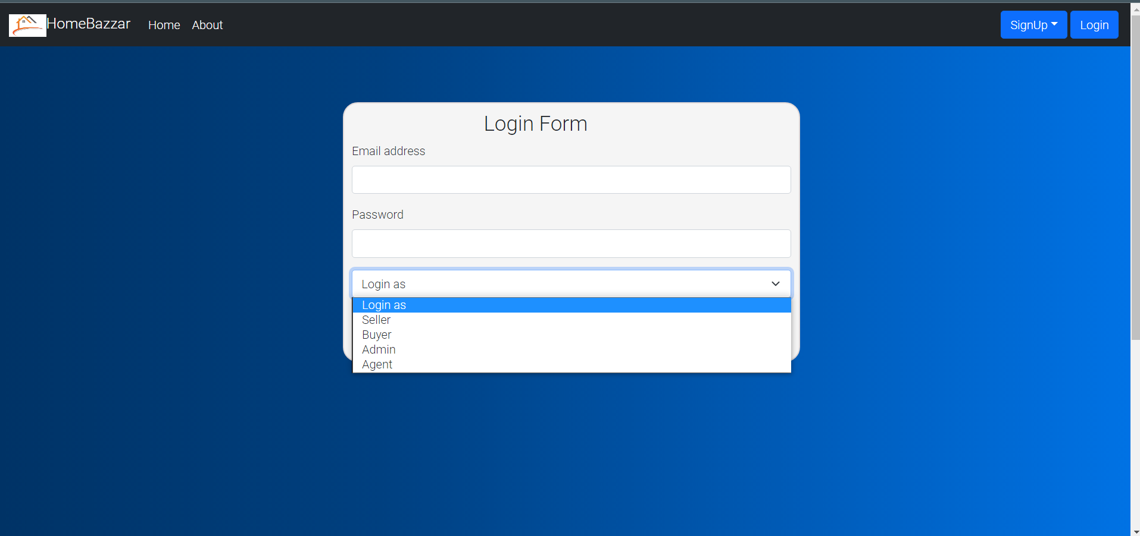
Users will be able to login to their account using email address and password.

Slide 9
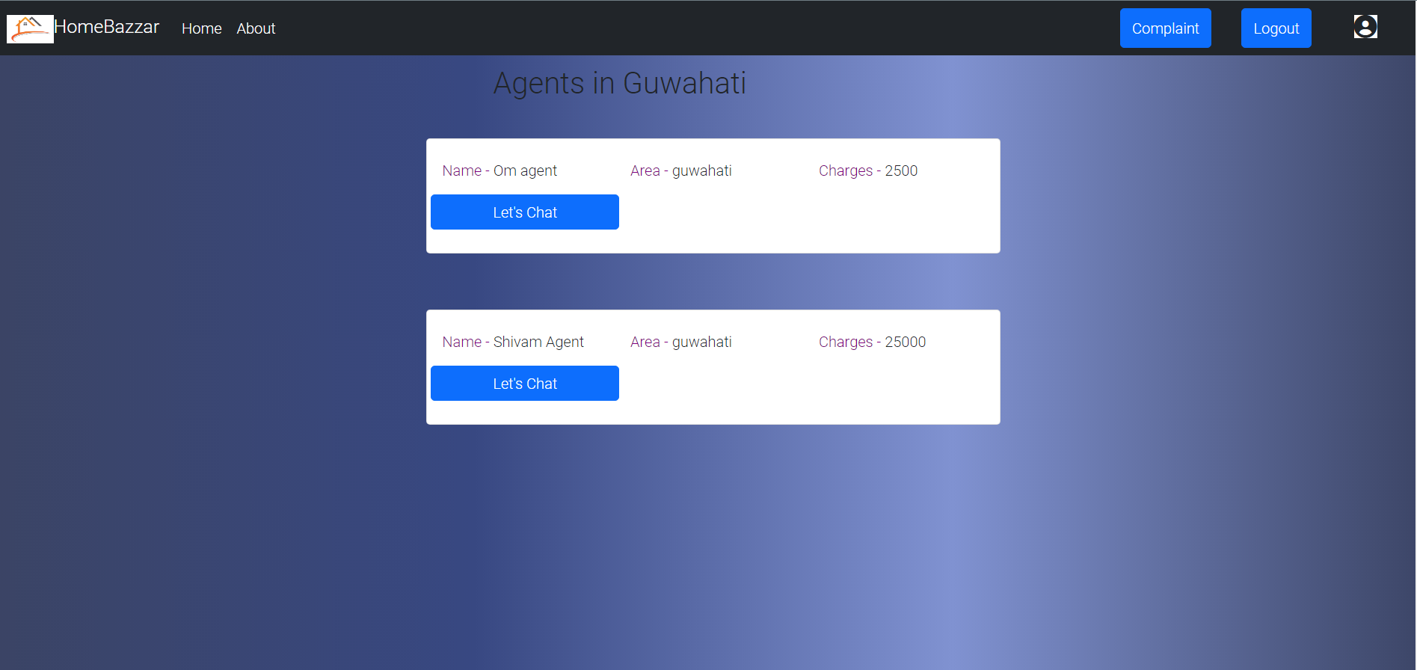
All the available agents will be listed along with brief description about them.

Slide 10
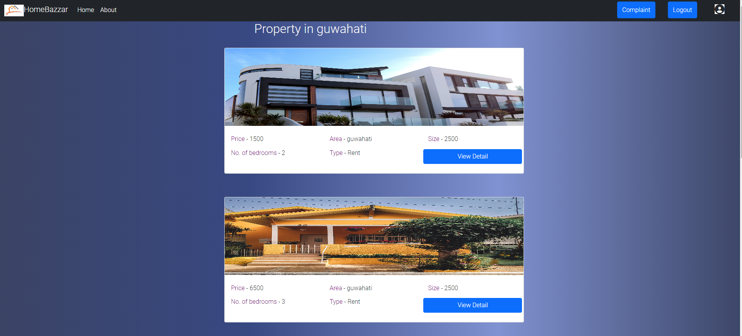
All the matching apartments will be listed along with brief description about the apartment.

Slide 11
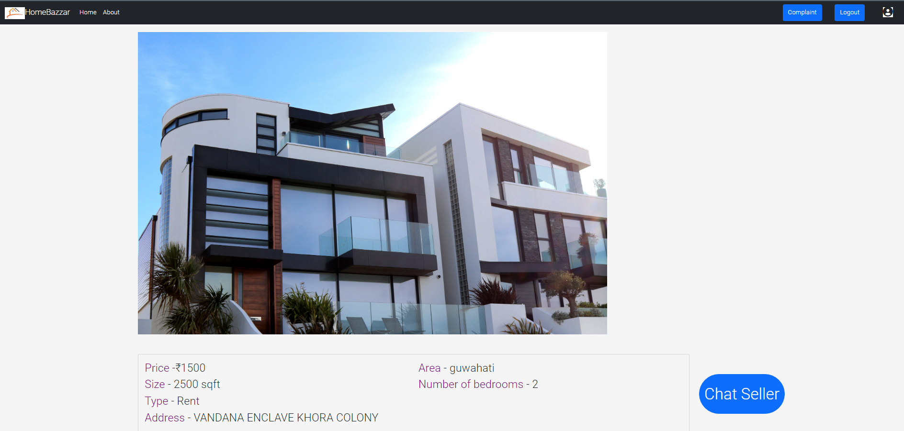
A detailed information of the apartment can be seen after clicking on it

Slide 12
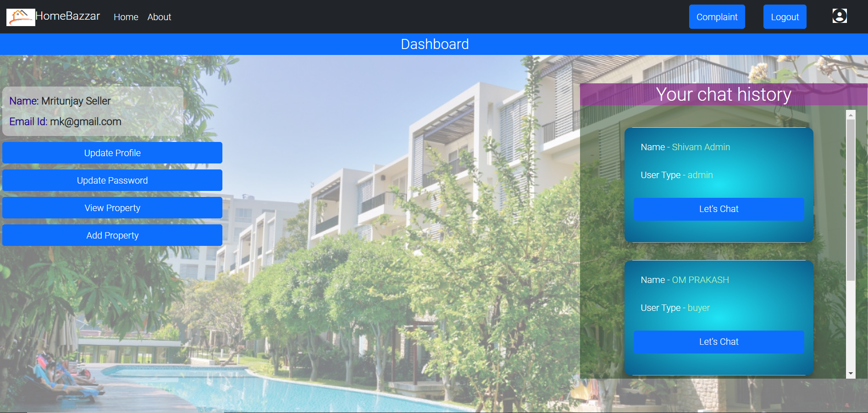
User’s Dashboard(to update profile, chat, etc.,

Slide 13
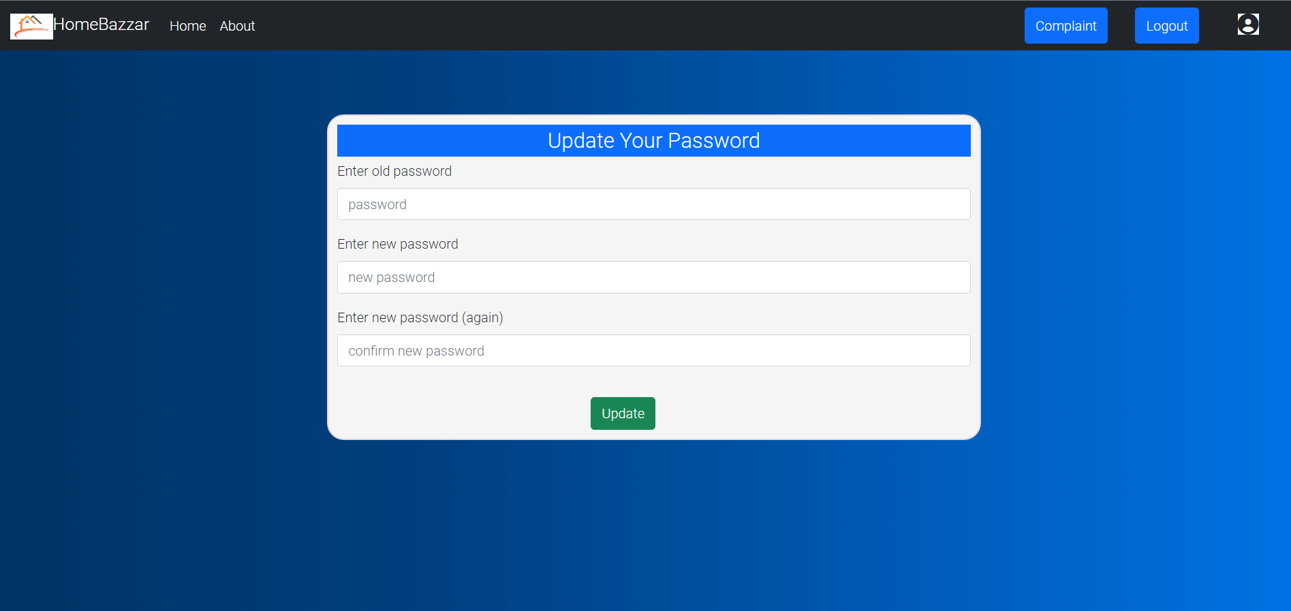
User can update password by providing his/her old password and new password.

Slide 14
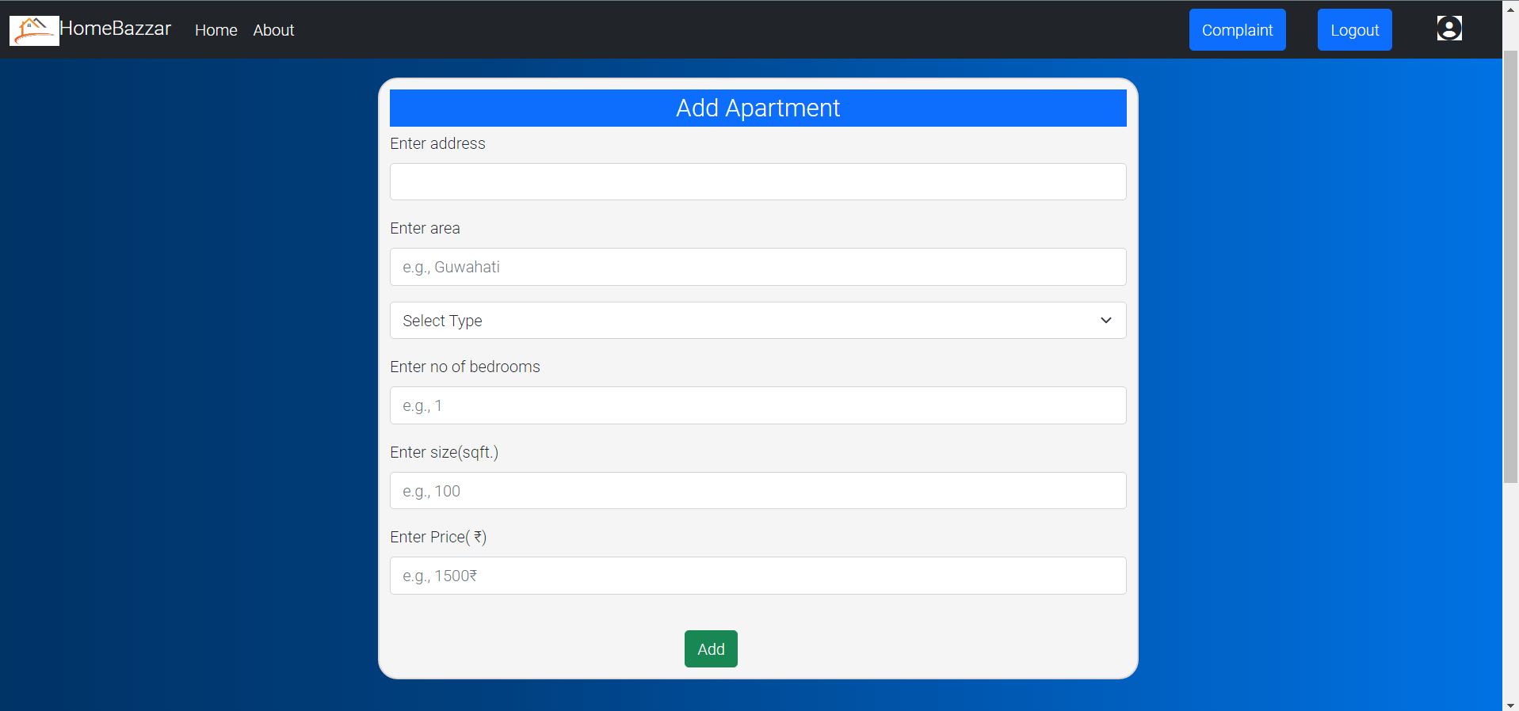
Seller must provide details(address, area, type, price, etc.,) to add apartments.

Slide 15
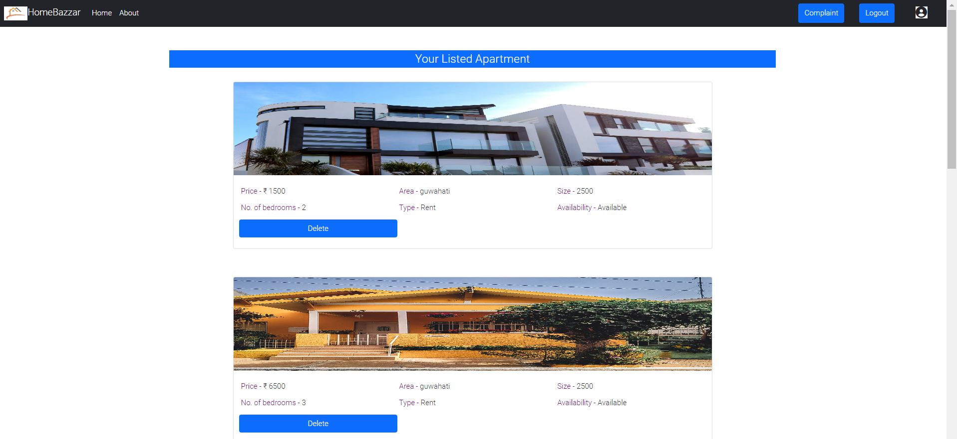
Seller can see(and delete) his/her all registered apartments on the application.

Slide 16
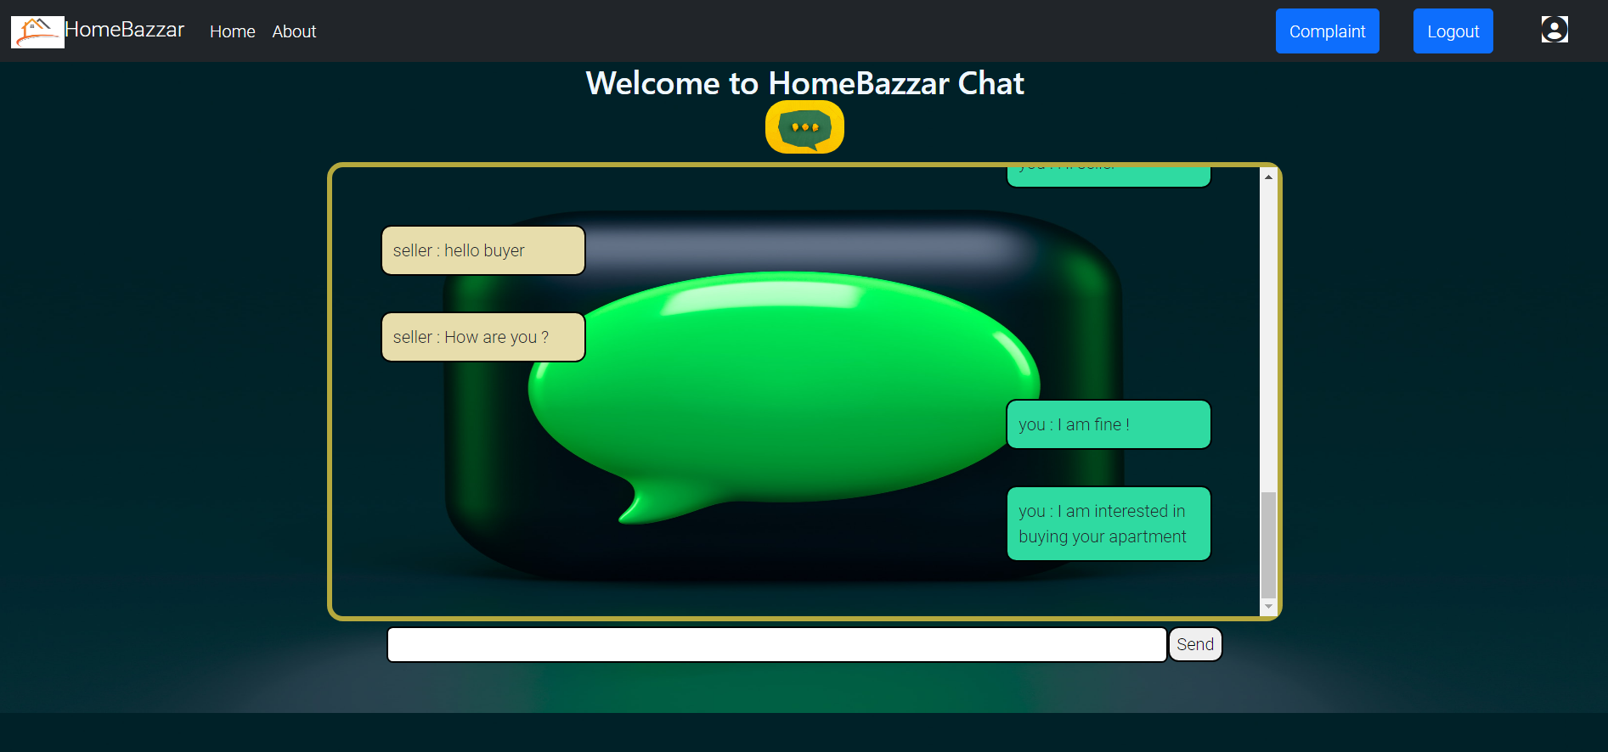
Chat feature(between two interested users).

Slide 17
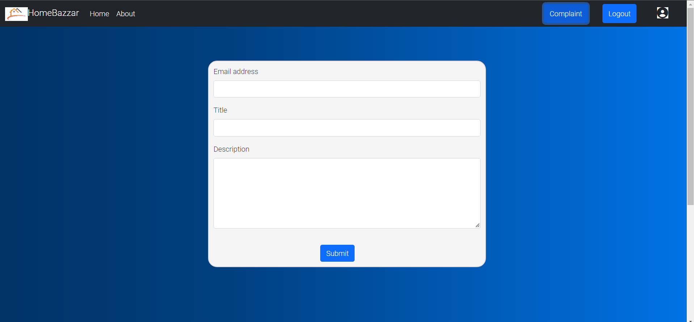
Complaint can be made by logged in users.

Slide 18
ADMIN

Slide 19
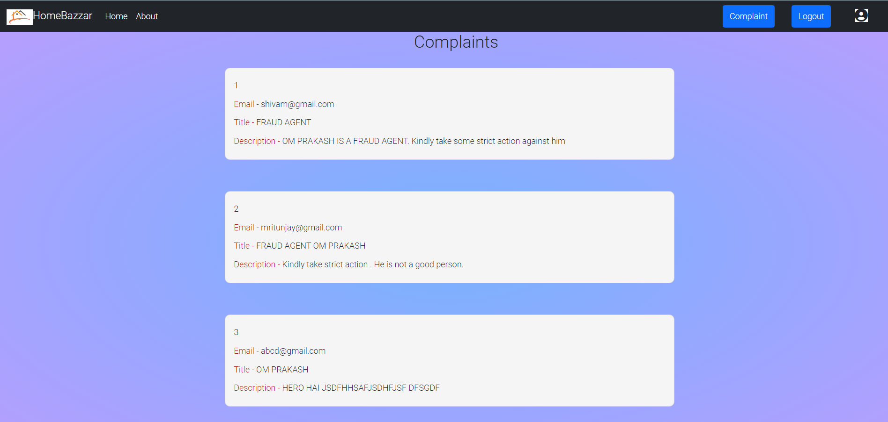
All registered complaints can be seen by admin.

Slide 20
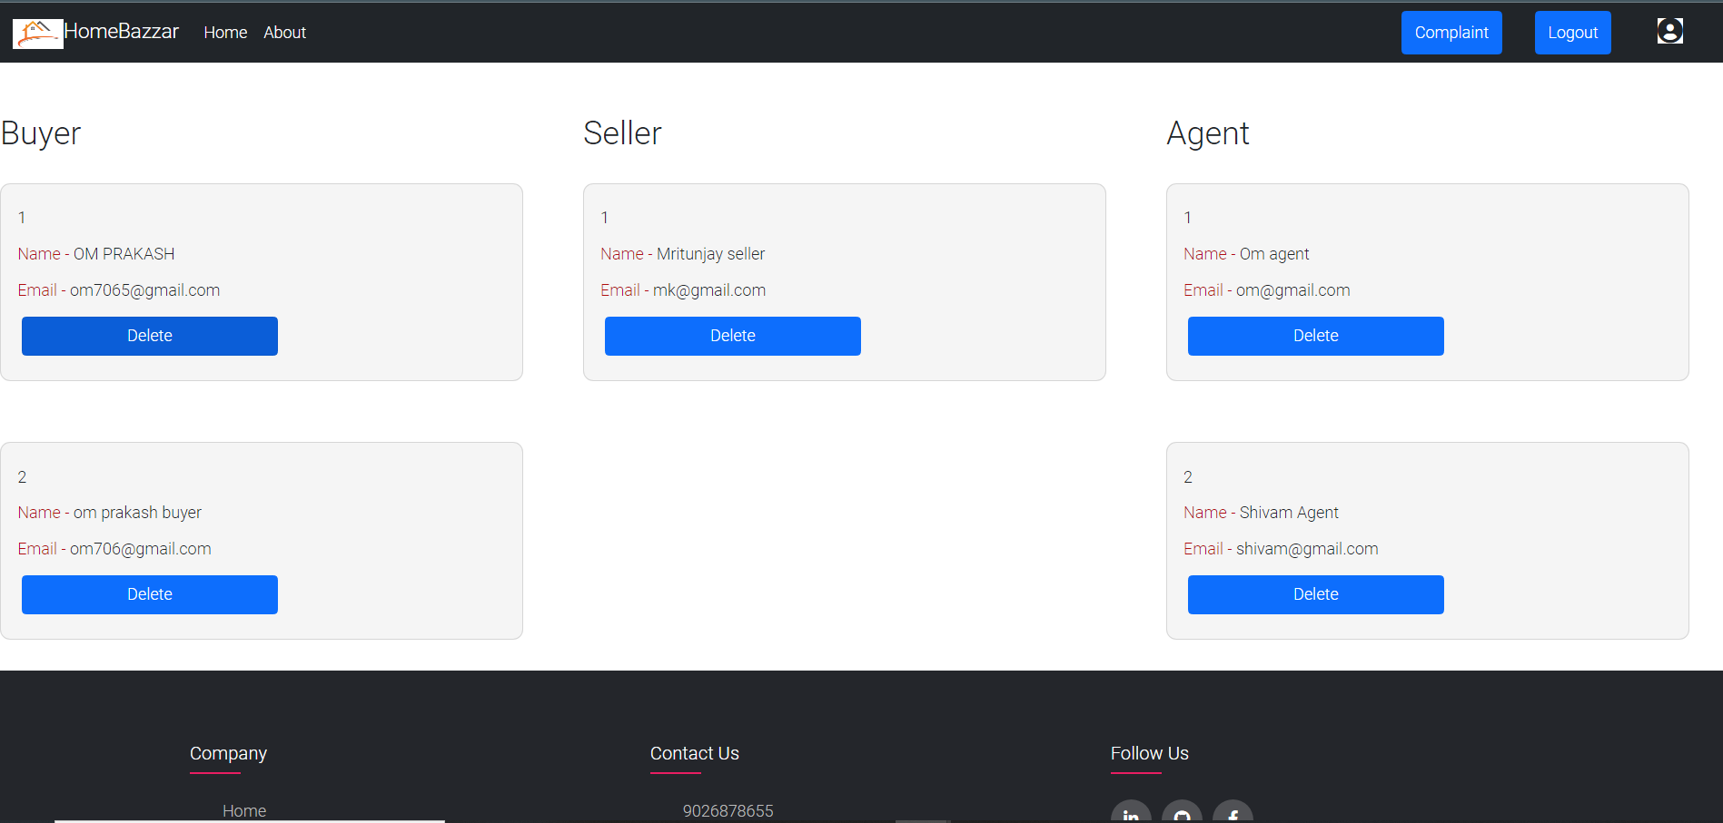
Admin can manage(delete/view) all the users registered on the application.

